Slide 1
Analyzing Amazon Sales data

Slide 2
Introduction
Analyzing Amazon sales data involves examining detailed metrics on product performance, customer behavior, and market trends. This analysis provides insights into sales volume, revenue patterns, and inventory management. By leveraging this data, businesses can optimize their strategies, forecast demand, and enhance their competitive edge. Effective analysis ultimately drives better decision-making and strategic growth.

Slide 3
Problem Statement
Sales management has gained importance to meet increasing competition and the need for improved methods of distribution to reduce cost and to increase profits. Sales management today is the most important function in a commercial and business enterprise. # Sales-trend: Month-wise, Year-wise, Yearly-month-wise.

Slide 4
Techniques used to solve problem :-
1. Date Hierarchies: Use Power BI's built-in date hierarchies to easily drill down from yearly to monthly and daily levels. Create a Date Table with columns for Year, Month, and Day to facilitate this hierarchical analysis. 2. Visualizations: Use column charts, line charts, and area charts to visualize sales trends over time. Create separate visualizations for month-wise, year-wise, and combined yearly-month-wise data to highlight different aspects of the trend.

Slide 5
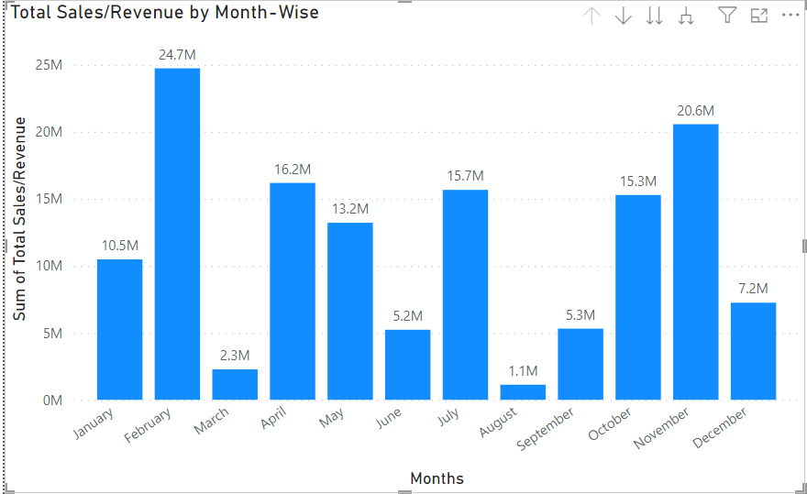
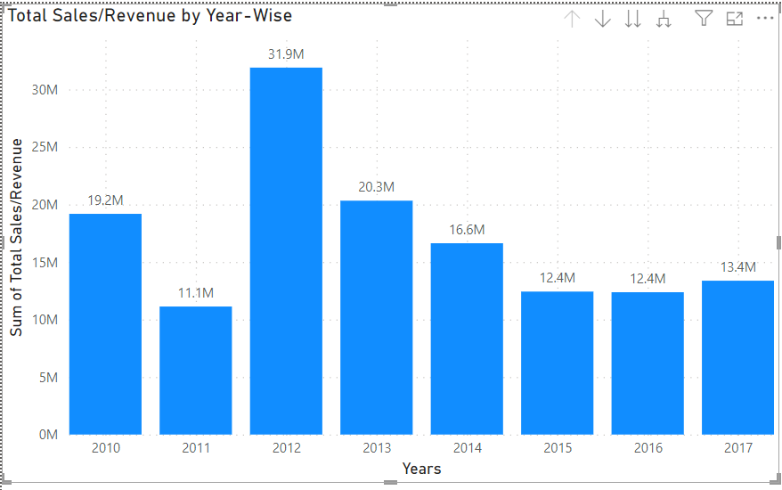
Output of Project :-

Slide 6
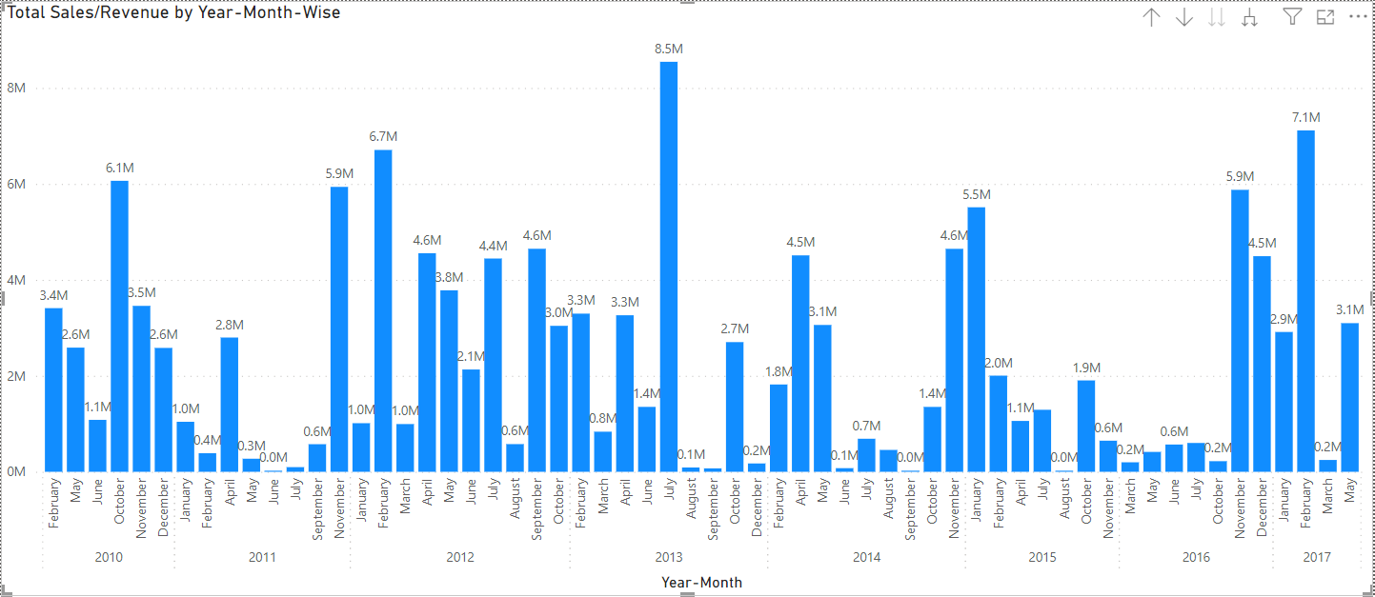
Output of Project :-

Slide 7
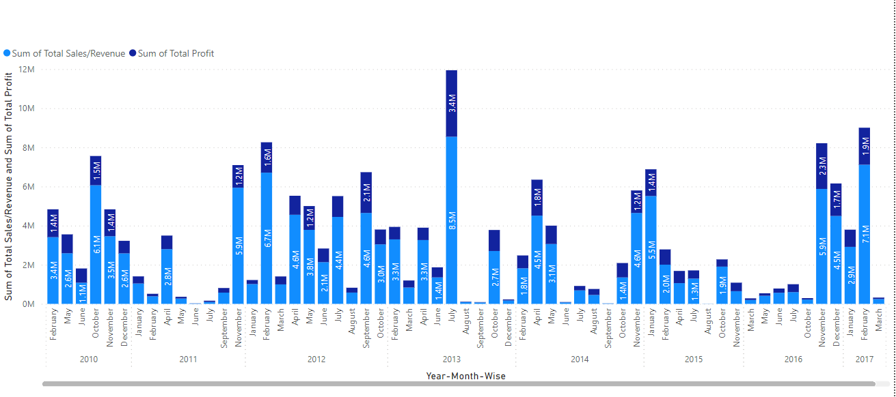
Output of Project :-

Slide 8
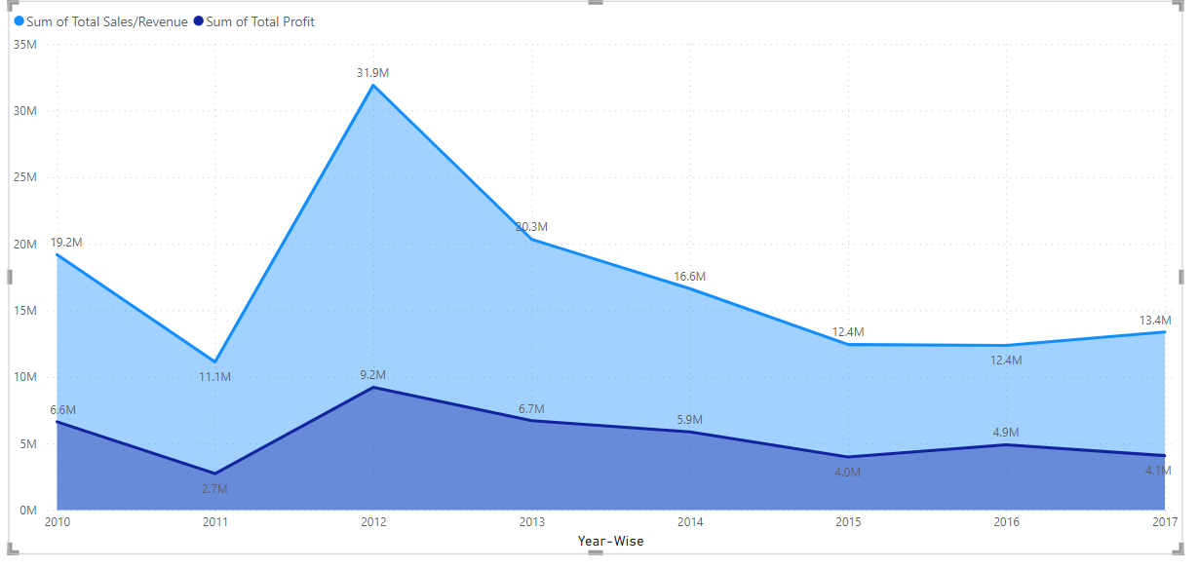
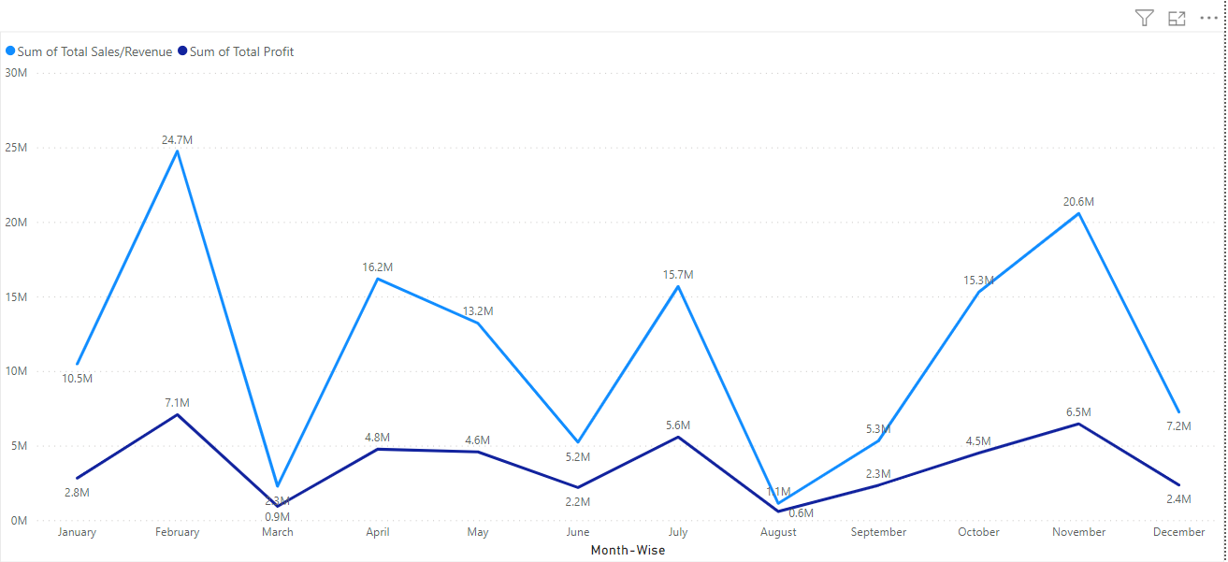
Output of Project :-

Slide 9
Thank you

